Slide 1
KKR vs RCB Match Analysis
A Data-Driven Breakdown of the Game
Presented by- Goutham and Nikhil

Slide 2
CONTENTS
Introduction
Importing Libraries & Data Preprocessing
Player Performance Analysis
Team-wise Stats
Match Summary
Visualizations
Conclusion & Insights

Slide 3
Introduction
Brief overview of the match
The match between KKR and RCB was held at Eden Gardens, Kolkata, on March 22, 2025 as part of the league stage.
KKR Innings: KKR scored 174/8, with Rahane (56 runs) and Narine (44 runs) leading their batting. RCB’s bowling attack was led by Krunal Pandya (3 wickets) and Hazelwood (2 wickets).
RCB Innings: RCB chased the target successfully, scoring 177/3. Kohli (59 runs) and Phil Salt (56 runs) were top scorers. KKR’s bowlers managed only 3 wickets, taken by Narine, Vaibhav Arora, and Varun Chakravarthy.
Result: RCB won the match by 7 wickets, displaying a strong batting performance.
Importance of data-driven cricket analytics
Modern cricket relies heavily on data analytics to improve strategies, player performance, and game tactics.
Teams use historical match data to predict outcomes and adjust strategies dynamically.
Player statistics help identify strengths, weaknesses, and key areas of improvement.
Bowling analytics analyze speed, accuracy, and effectiveness against different batsmen.
Batting metrics like strike rate and boundary percentage influence batting order and approach.
Match simulations based on data help teams plan successful chases or set competitive targets.
Data visualization tools simplify complex statistics, making insights more accessible.
Helps talent scouts identify emerging players based on performance trends.
Overall, data-driven analysis enhances accuracy in cricket decision-making and strategy execution.

Slide 4
Importing Libraries & Data Preprocessing
Libraries used: Pandas, NumPy, Matplotlib
import numpy as np
import pandas as pd
import matplotlib.pyplot as plt
Reading the CSV file
df = pd.read_csv(r'C:\Users\Admin\Documents\rcb_vs_kkr.csv') print(df)
Cleaning and handling missing values
df.info() -- Provides a concise summary of a dataframe.
df.head() -- It displays first 5 rows of the dataframe.
df.tail() -- It displays the last 5 rows of the dataframe.
df.duplicated() -- Identifies and flags duplicate rows within a dataframe.
df.duplicated().sum -- It is used to count the number of duplicate rows in a dataframe.
df.drop_duplicates() -- It removes or deletes the duplicate values.
df.describe() -- It generates a descriptive statistics of a dataframe.
df.fillna() -- It is used to fill the missing values of a dataframe.
df.isnull() – It is used to find the missing values of a dataframe.
df.dropna() – It is used to remove or delete the missing values of a dataframe.

Slide 5
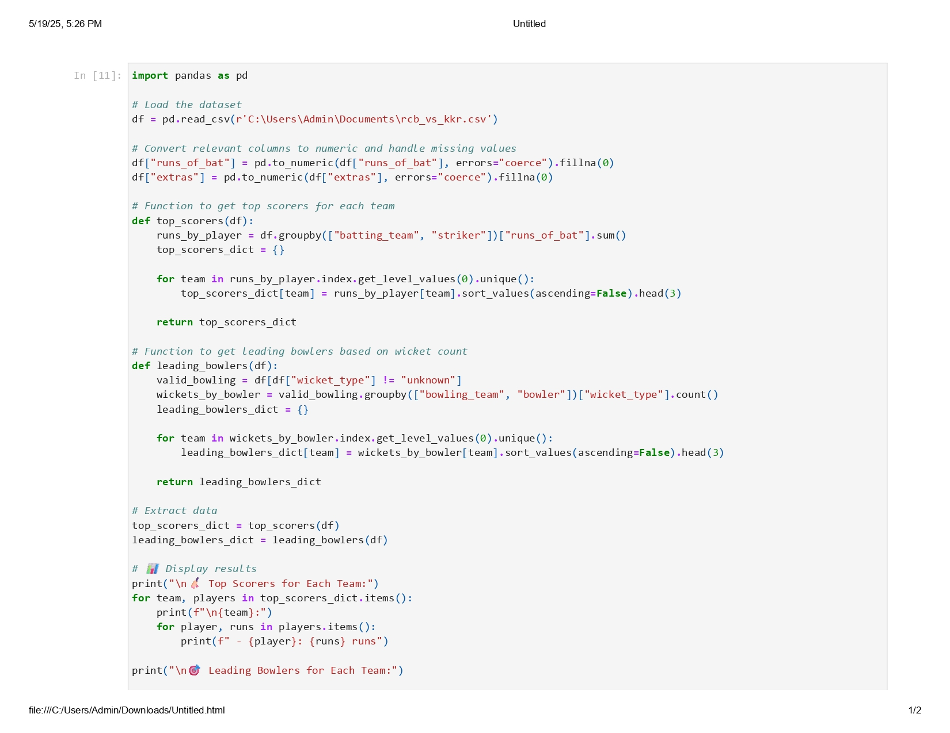
Player Performance Analysis
Top scorers from each team
Leading bowlers based on wicket count

Slide 6
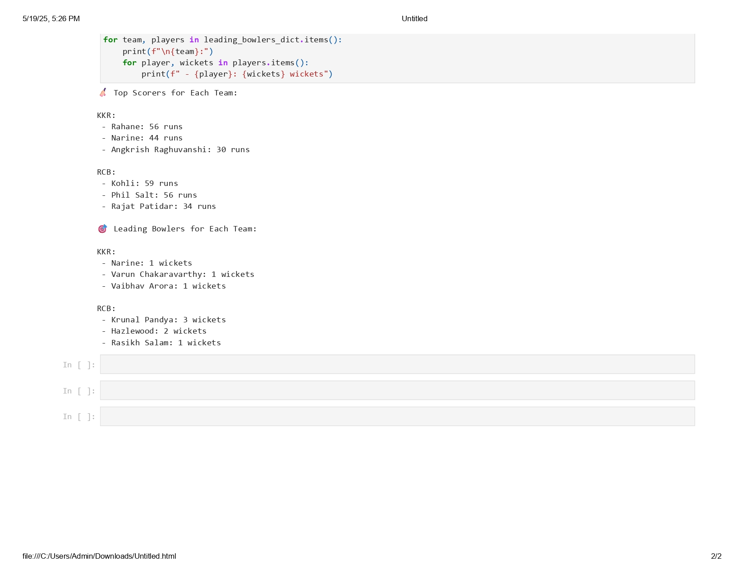

Slide 7
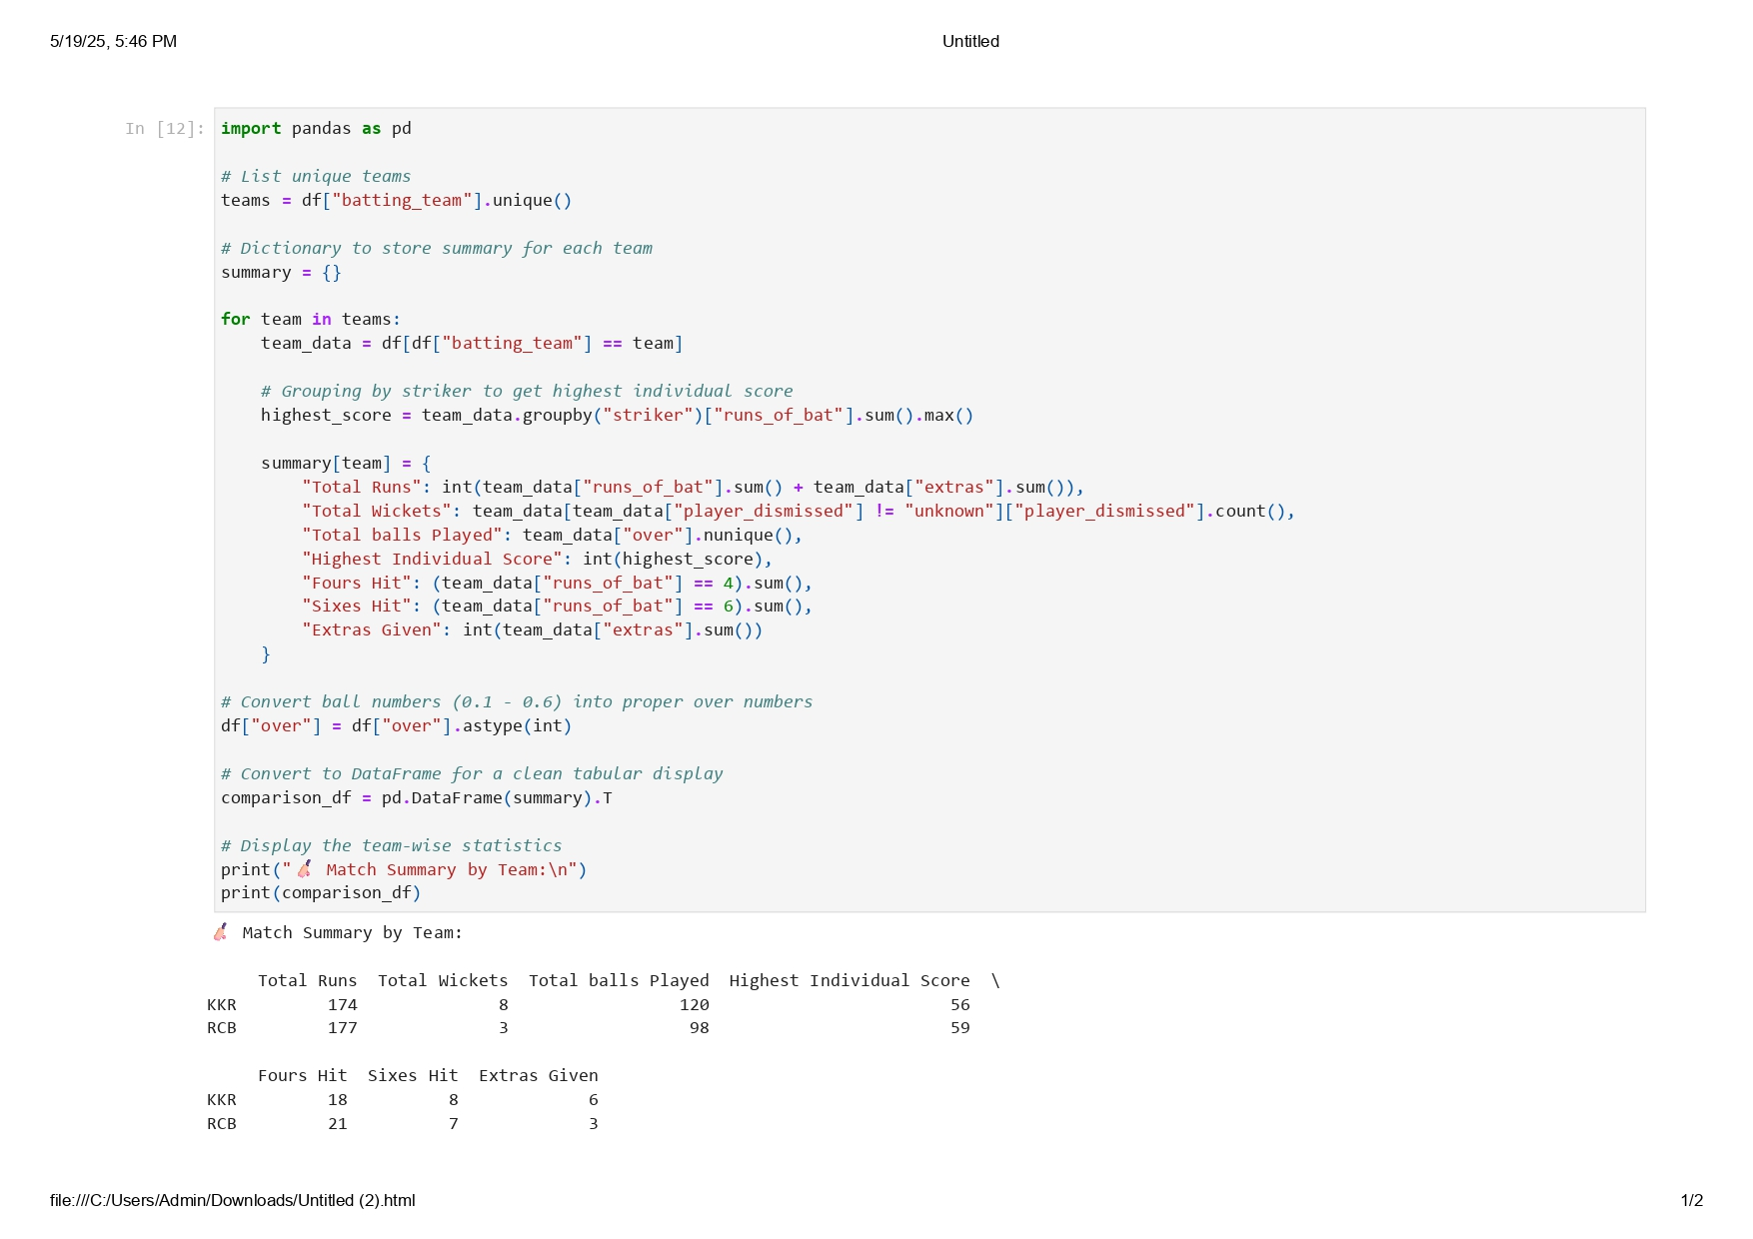
Team-wise Stats
Overall team statistics (runs, wickets, balls played, boundaries, extras)

Slide 8
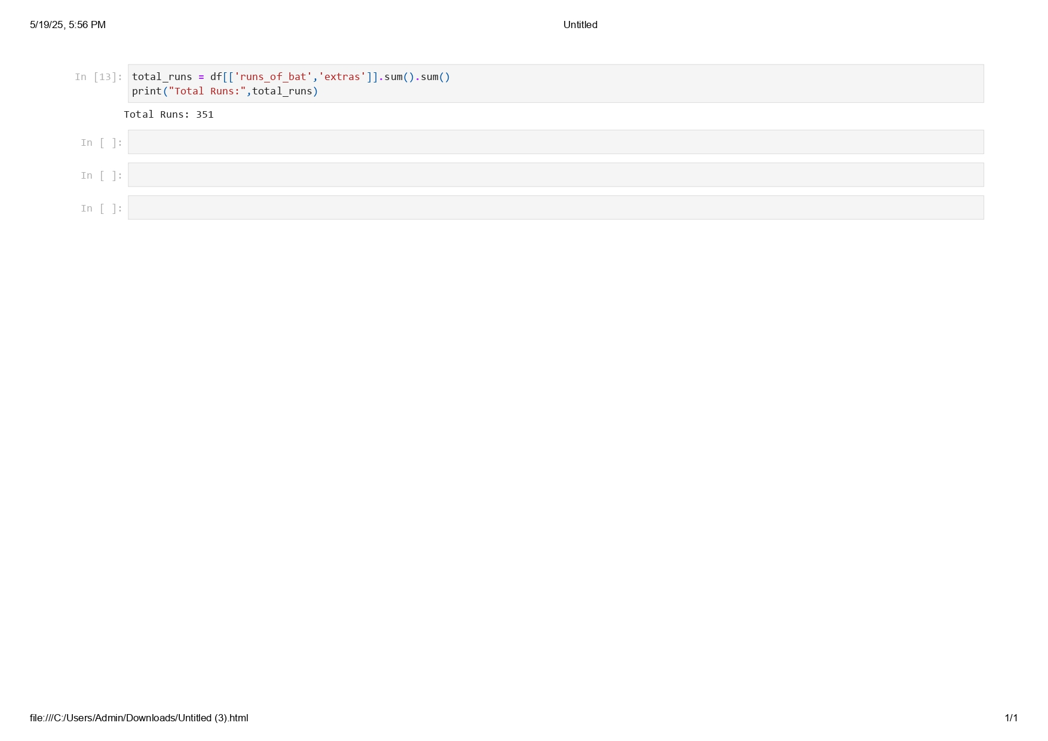
Match Summary
Total runs scored by both teams(including extras)

Slide 9
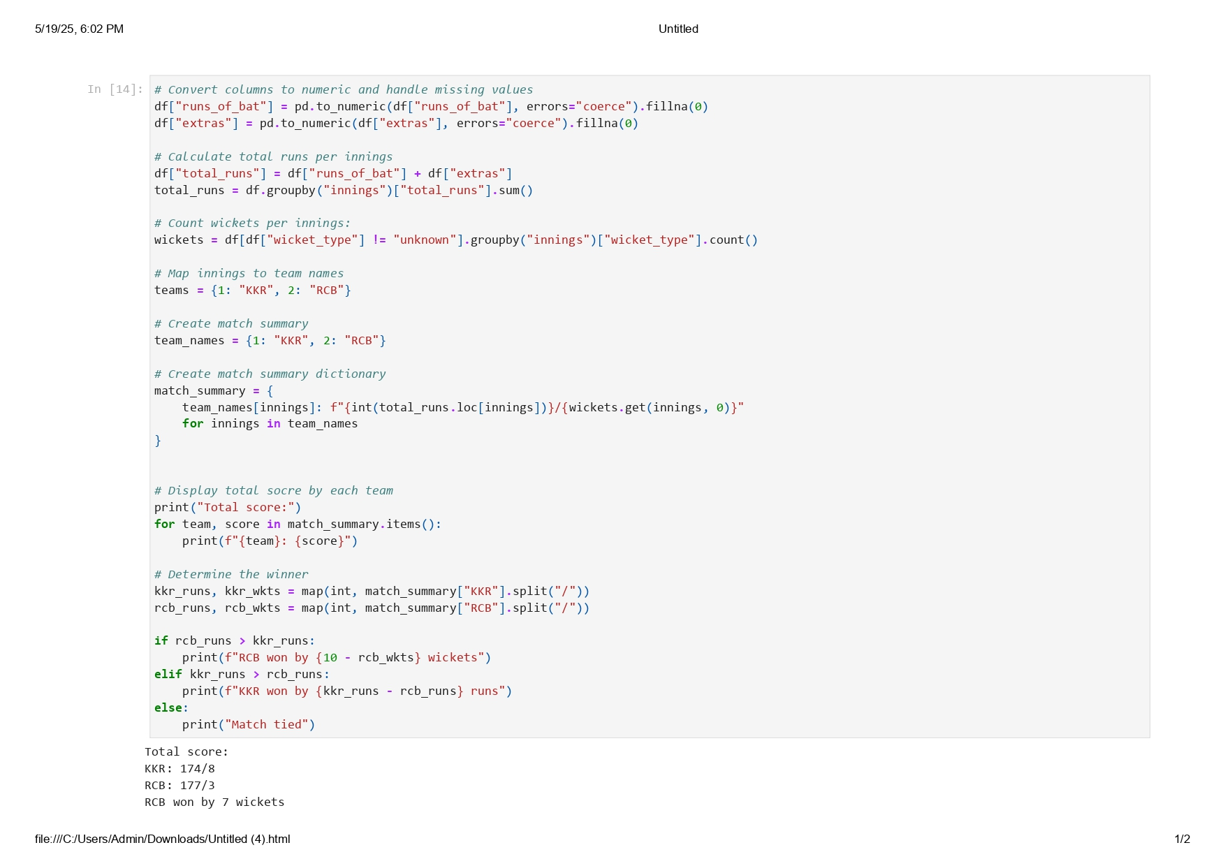
Team-wise scores with fall of wickets and Determining the match winner

Slide 10
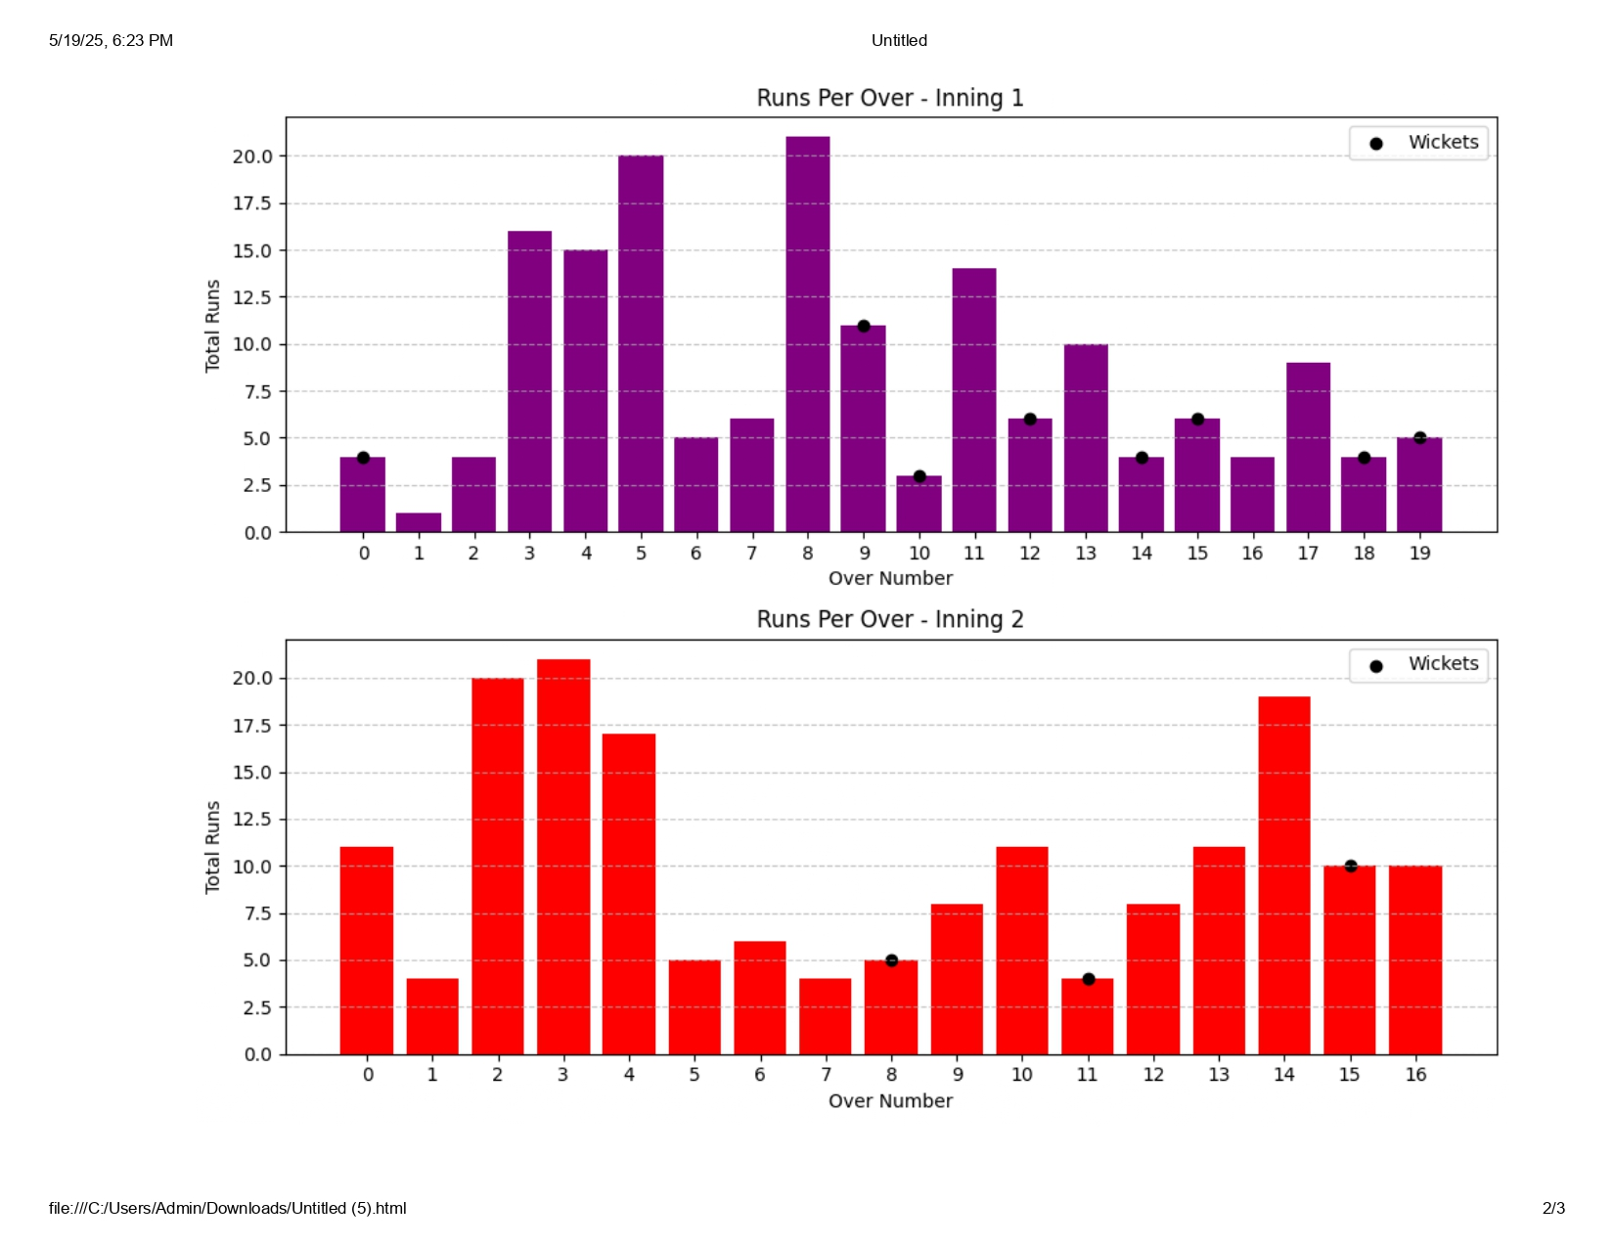
Visual Representations Bar Graph: Runs scored per over with wicket markers
The bar graph visualizes total runs scored per over, highlighting key moments where wickets fell.
X-Axis: Represents the over number (1 to 20 for each innings).
Y-Axis: Displays the total runs scored in each over.
KKR's innings: Bars are colored purple. RCB's innings: Bars are colored red.
Wicket Markers: Black dots are placed above bars to indicate overs where wickets fell.
Identifies high-scoring overs and key moments where wickets impacted the game.
Helps compare the scoring pattern between KKR and RCB.

Slide 11
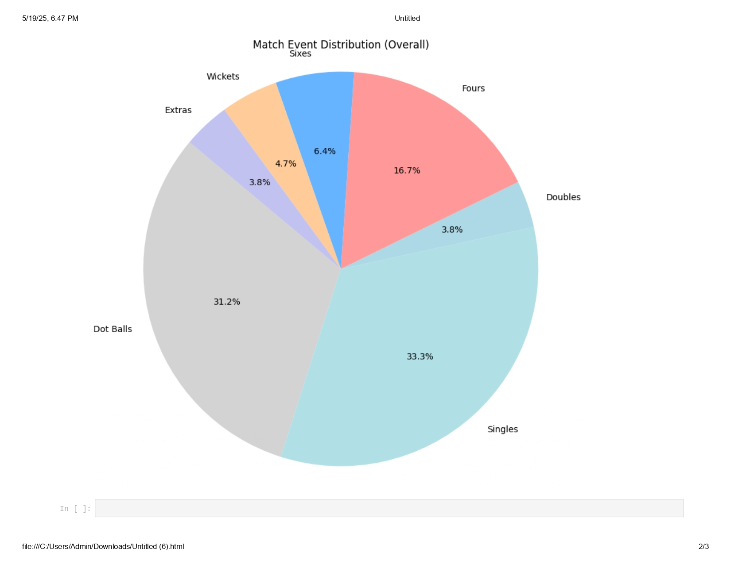
Pie Chart: Match event distribution (dot balls, boundaries, wickets, extras)
This pie chart represents the distribution of full match event during the KKR vs RCB game.
Dot Balls (31.2%) - These were deliveries where no runs were scored, showing the bowlers’ effectiveness.
Singles (33.3%) - The most frequent scoring type, indicating steady strike rotation.
Fours (16.7%) & Sixes (6.4%) - Boundaries contributed a significant portion of the total runs.
Wickets (4.7%) - This slice represents the total dismissals in the match.
Doubles (3.8%) - Occasions where batsmen ran two runs between deliveries.
Extras (3.8%) - Runs conceded through wide's, no-balls, and byes.
This graph shows the majority of runs came from singles and boundaries, highlighting a mix of aggressive and cautious batting.
Dot balls and wickets indicate bowling pressure and missed scoring opportunities.
Extras plays a minor role but still contributed to the final score.

Slide 12
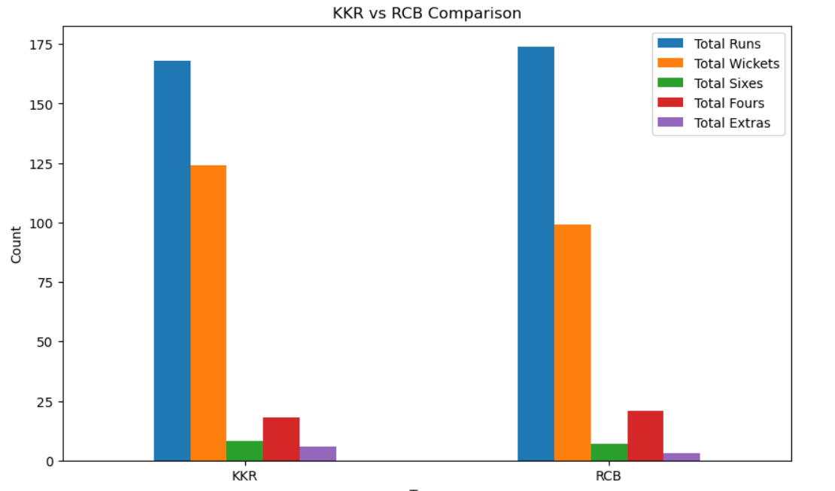
Comparison Graph: Head-to-head comparison between KKR and RCB
This bar chart provides a comparative analysis of key match statistics between KKR and RCB.
The X-Axis represents the two teams: KKR and RCB.
The Y-Axis represents the count of different performance metrics, such as Total Runs, Wickets, Sixes, Fours, and Extras
Different colors are used to distinguish the categories: Blue used for total runs scored, Orange used for total wickets fall, Green used for total sixes hit, Red used for total fours hit, Purple for extra’s conceded.
This graph Provides a quick comparison of the teams’ performance across different metrics.
Useful for identifying strengths and weaknesses for future strategy adjustments.

Slide 13
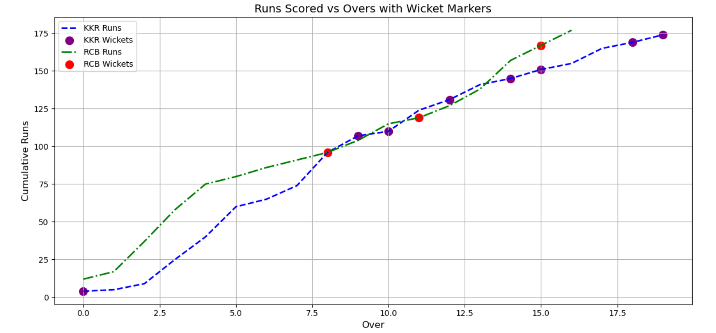
Line Chart: Cumulative runs vs overs with fall of wickets
This bar graph visually compares KKR and RCB across key match statistics.
Y-axis represents the cumulative runs which means the total number of runs a team has scored throughout entire match including extras.
X-axis represents the overs .
Single green color(-) line represents RCB scores and double blue color(--) line represents KKR scores.
This graph shows the variation in runs along with overs .
Purple tick marks represents the wicket fall for KKR in that particular over.
Red tick marks shows the wicket fall for RCB in that particular over.
This graph helps in strategic decision-making to coaches and analyst’s they can use this comparison to refine team strategies.
This graph is useful for post-match discussions, media coverage, and presentations.
It visually conveys the match summary in a clear and effective manner.

Slide 14
Conclusion and Insights
The match analysis of KKR vs RCB presents a compelling breakdown of team performances, individual contributions, and key moments that shaped the game. RCB’s victory by 7 wickets was driven by their strategic batting approach, capitalizing on consistent strike rotation and efficient boundary-hitting. While KKR showcased their explosive intent with more sixes, their higher wicket loss hindered their momentum. The bowling efforts from Krunal Pandya and Hazlewood were impactful against KKR, whereas Narine and Vaibhav Arora tried to contain RCB’s chase but struggled to create breakthroughs. The data-driven insights, including bar graphs, pie charts, and statistical comparisons, reveal that RCB’s disciplined approach in run accumulation and minimal wicket loss played a crucial role in securing their win. The analysis not only highlights areas for improvement, such as KKR’s stability in partnerships and controlling extras, but also offers valuable takeaways for future match strategies. This comprehensive breakdown enables cricket analysts and enthusiasts to understand performance trends, refine game plans, and appreciate the nuances of competitive T20 cricket.

